Slide 1


RSA & SALTED HASH
Syed - 301318212
Deepak balaji prabu - 301304684
Nirojan jeyandran – 300807665
Mohammad yousef - 301335063

Slide 2






Slide 3
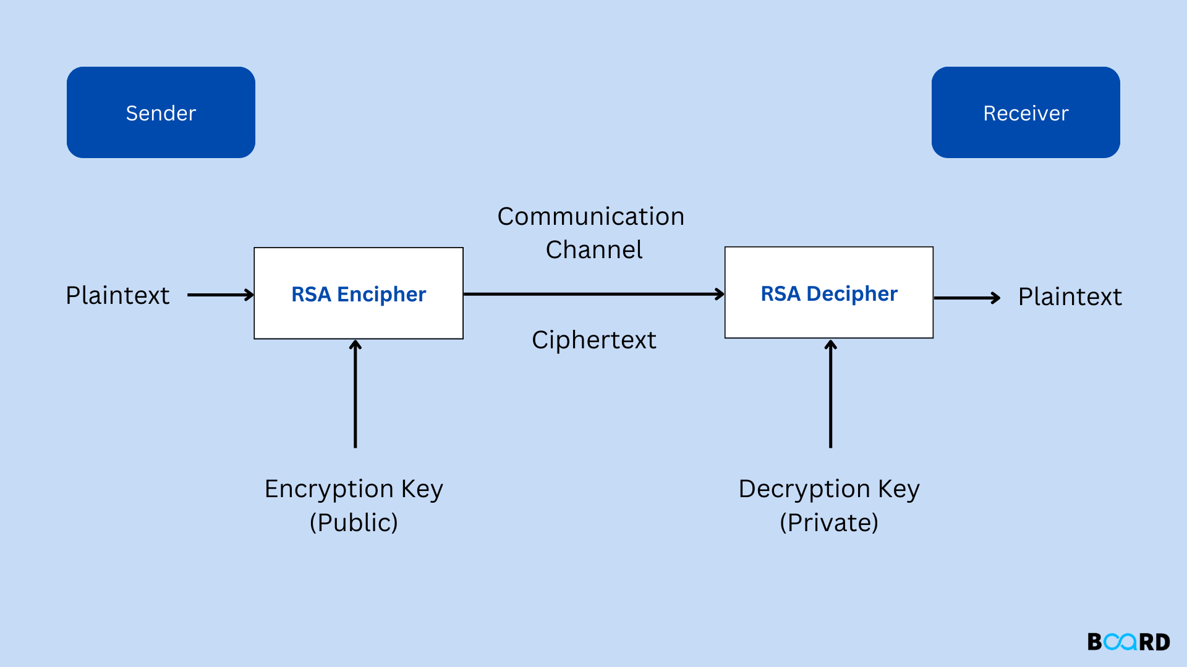

Slide 4
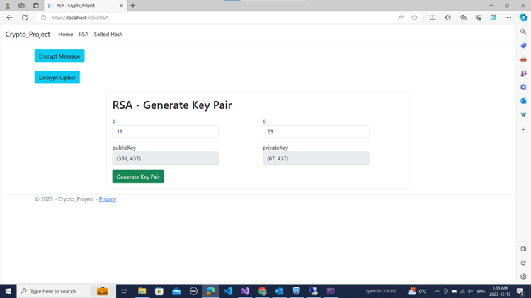

Slide 5
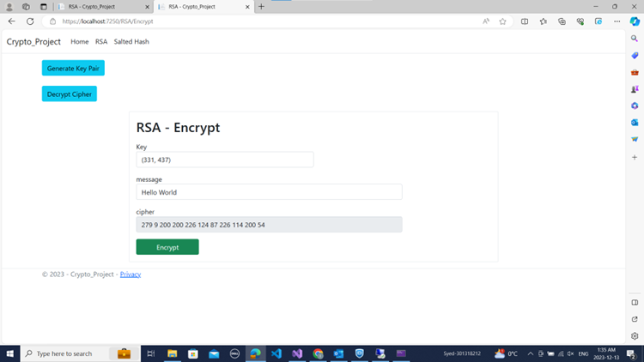

Slide 6
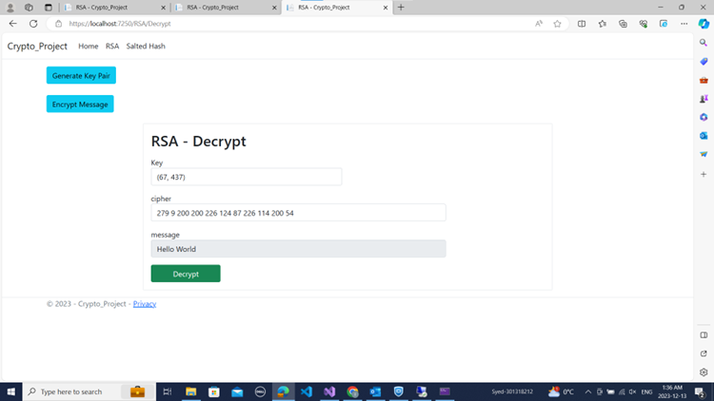

Slide 7
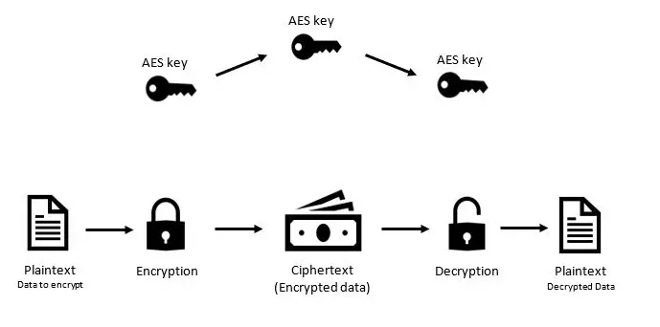
AES

Slide 8

Salted Hash

Slide 9
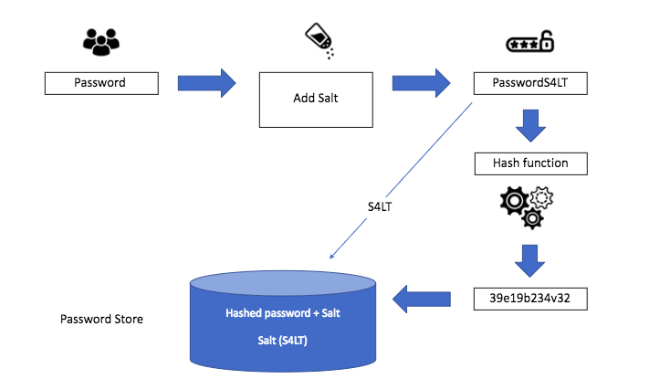

Slide 10
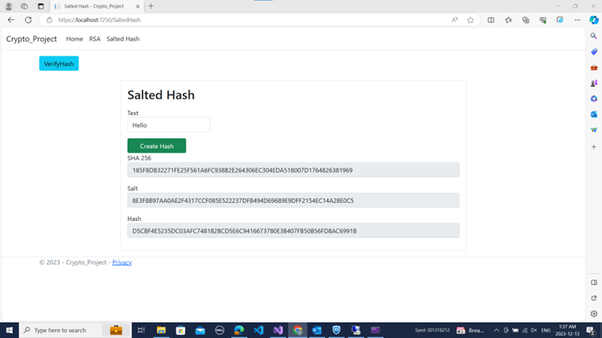

Slide 11
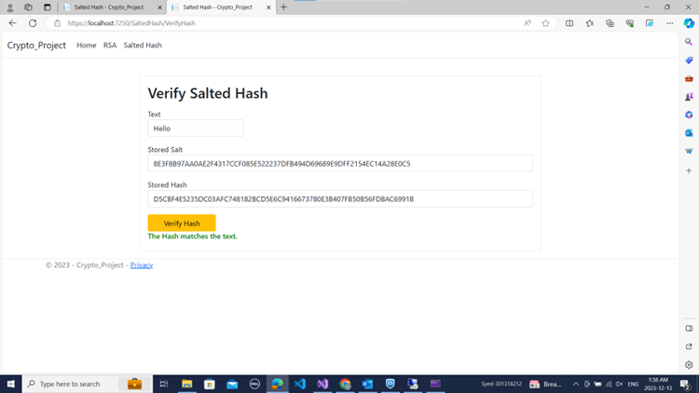

Slide 12
